Slide 1
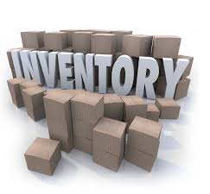

IS 436 Deliverable 3: Retail Inventory System
Leader Justin Chan
QA Parmeet Dua
Programmer Brandon Nguyen
Analyst Urgy Eado
QA Support Jaime Pineda
Project Manager Rafay Khurram
Editor Raj Desai

Slide 2
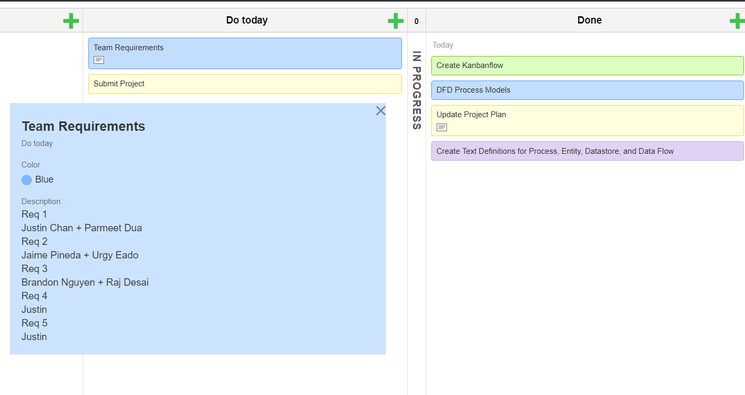

Slide 3
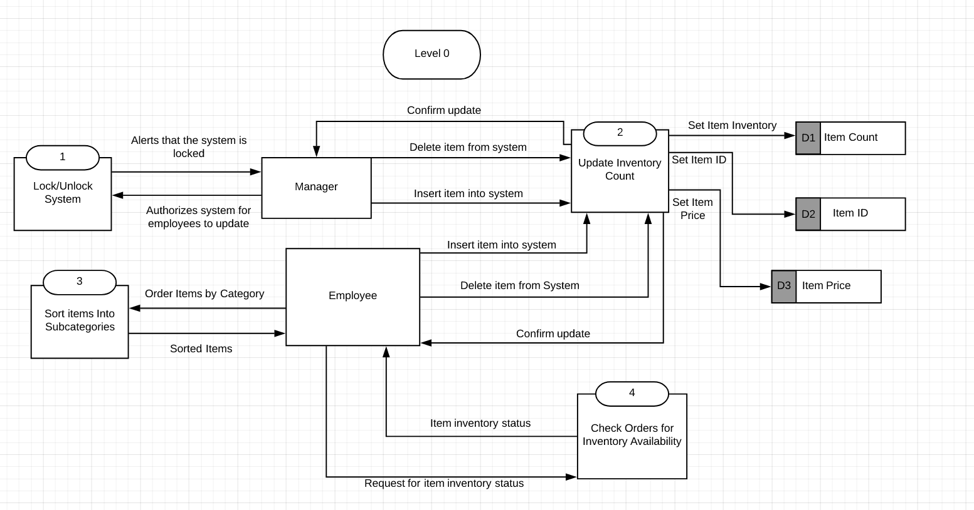

Slide 4
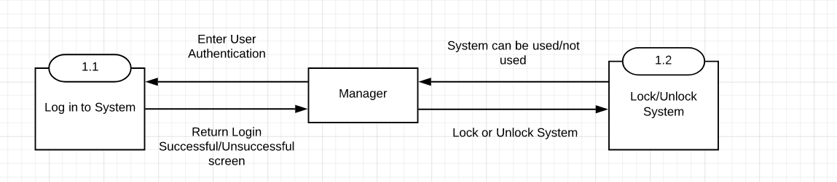

Slide 5
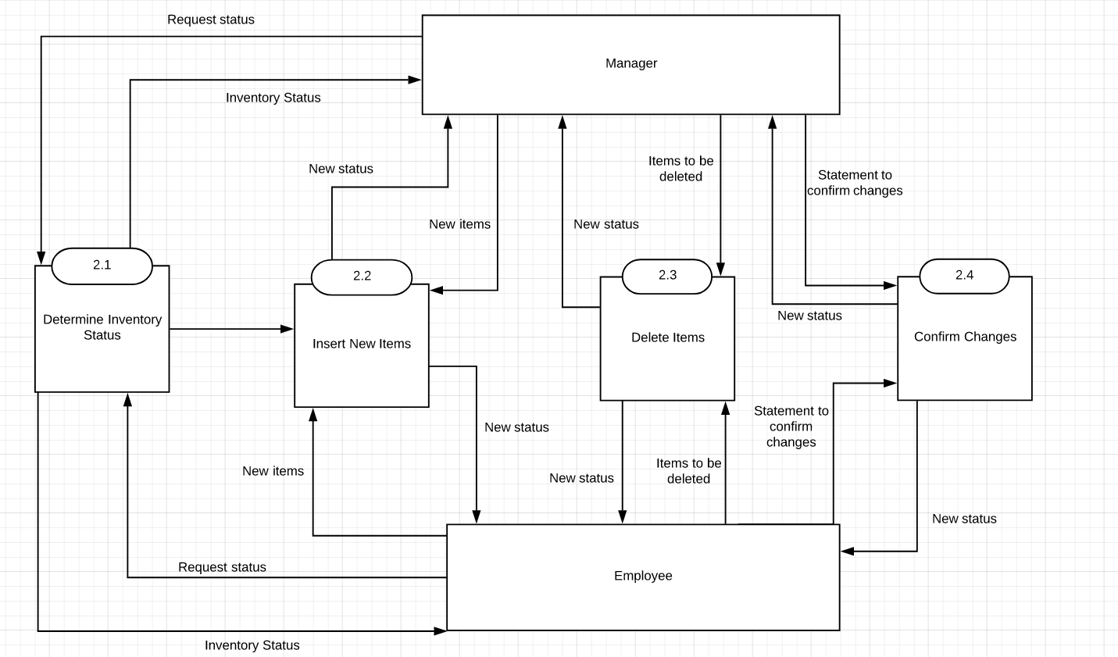

Slide 6
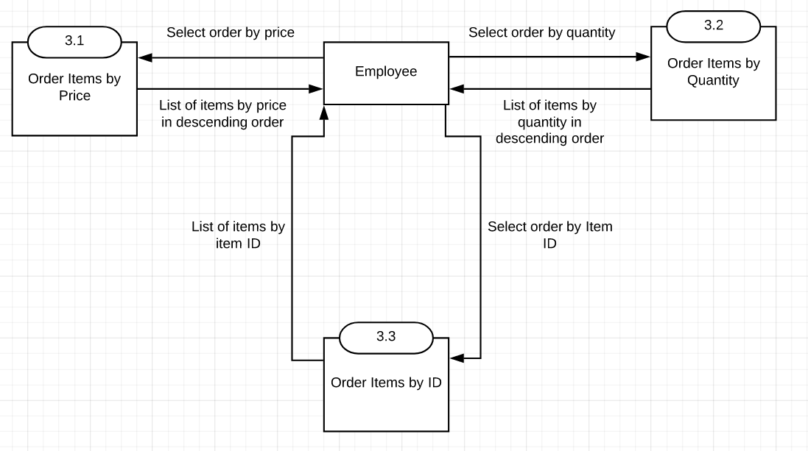

Slide 7
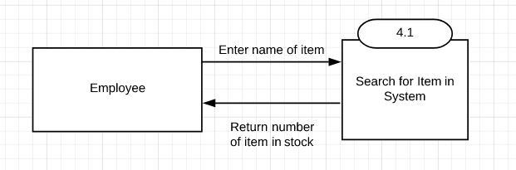

Slide 8
Use Case DFD

Slide 9
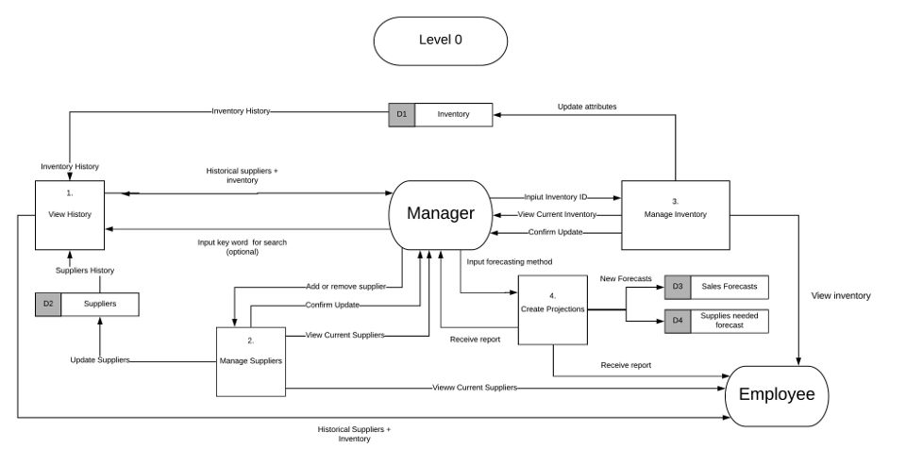

Slide 10
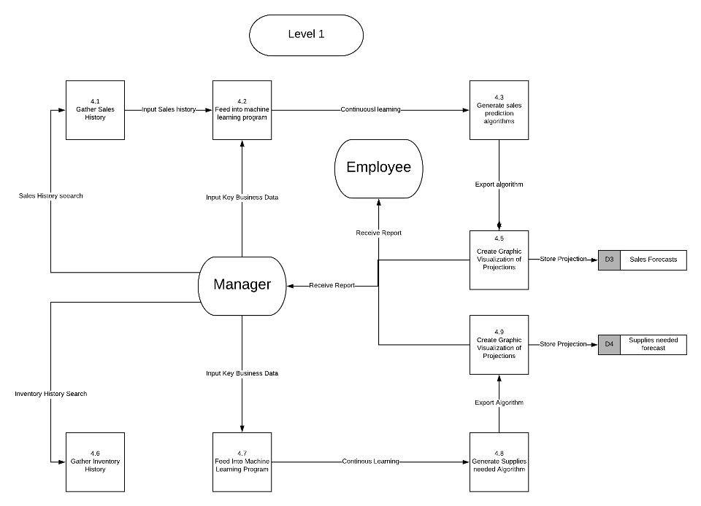

Slide 11
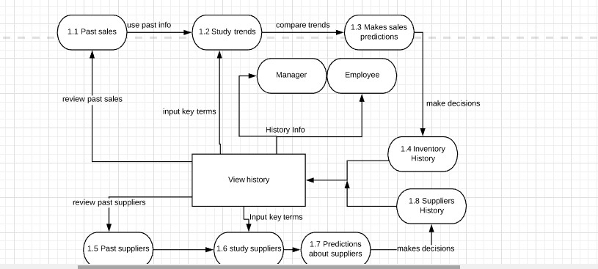

Slide 12
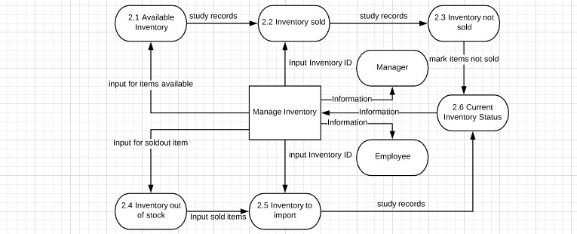

Slide 13
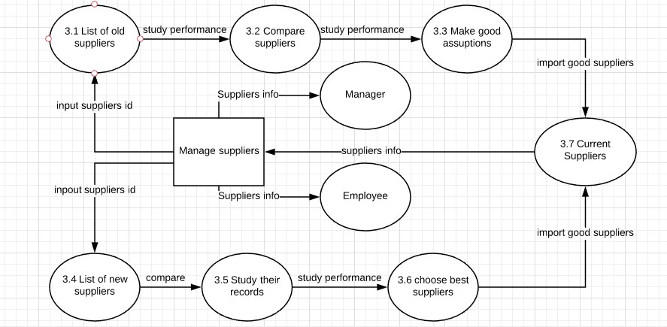

Slide 14
Text Definitions

Slide 15
Level 0 : Processes
Process 1 - Lock/Unlock System: Locking IMS so that changes cannot be made to it or unlocking it so that it can be updated.
Process 2 - Update Inventory Count: Add or delete items to and from the IMS.
Process 3 - Sort items Into Subcategories: Allows employees to sort items in the IMS for convenient viewing.
Process 4 - Check Orders for Inventory Availability: Reference the IMS to see if item is in stock to be able to fulfill an order.

Slide 16
Level 0 Entities/ Data Stores
Entities:
Manager: Person responsible for management of the store and the IMS, holds higher rank than employee.
Employee: Person employed by manager working in the store, has access to the IMS.
Data Stores:
Item Count: Number of items in inventory. Stored in the IMS.
Item ID: Unique ID number of item. Stored in the IMS.
Item Price: Price of item. Stored in the IMS.

Slide 17
Level 0 : Data Flows
Alerts that the system is locked: IMS alerts manager that it has been either locked or unlocked.
Authorizes system for employees to update: Manager unlocks system for use by employees or locks it.
Confirm update: Prompt asking employee to confirm change to the IMS.
Delete item from system: Manager/Employee deletes item from the IMS.
Insert item into system: Manager/Employee adds item to the IMS.
Set Item Inventory: Manager/Employee sets a specific item’s inventory count in the IMS.
Set Item ID: Manager/Employee sets a specific item’s ID in the IMS.
Set Item Price: Manager/Employee sets a specific item’s price in the IMS.
Order Items by Category: Employee requests to order items by a desired metric.
Sorted Items: The IMS returns a list of items ordered by the desired metric.
Request for item inventory status: Employee requests for a desired item’s availability in the store by referencing the IMS.
Item inventory status: The IMS returns the inventory status of the desired item.

Slide 18
Level 1 Processes:
Process 1.1 - Login to System: Manager authenticates themselves to access the IMS.
Process 1.2 - Lock/Unlock System: Locking IMS so that it cannot be accessed or unlocking it so that it can be accessed.
Process 2.1 - Determine Inventory Status: Request inventory status of an item in the IMS.
Process 2.2 - Insert New Items: Insert new items into the IMS.
Process 2.3 - Delete Items: Delete any items from the IMS.
Proces 2.4 - Confirm Changes: Prompt Manager/Employee to confirm any changes they have made to the IMS.
Process 3.1 - Order Items by Price: Employee requests to view items in the IMS ordered by item price.
Process 3.2 - Order Items by Quantity: Employee requests to view items in the IMS ordered by item stock count.
Process 3.3 - Order Items by ID: Employee requests to view items in the IMS ordered by item ID.
Process 4.1 - Search for Item in System: Request to view specific item by name.

Slide 19
Level 1 Entities/ Dataflow
Entities
Manager: Person responsible for management of the store and the IMS, holds higher rank than employee.
Employee: Person employed by manager working in the store, has access to the IMS.
Dataflow
Enter User Authentication: Manager enters their username and password to log onto the IMS.
Return Login Successful/Unsuccessful screen: IMS either returns success or failure screen upon login attempt.
System can be used/not used: Changes cannot be made to the IMS while locked.
Lock or Unlock System: Manager locks or unlocks the IMS.
Request Status: Manager/Employee requests inventory status of an item in the IMS.
Inventory Status: IMS returns desired item’s inventory status.

Slide 20
Level 1 Dataflows Cont…
New items: Employee/Manager inserts new items into the IMS.
New status: IMS Returns status of newly added item.
Items to be deleted: Employee/Manager selects items to be deleted from the IMS.
Statement to confirm changes: Confirmation prompt for any change made to the IMS.
Select Order by Price: Employee selects to order items in IMS by item price.
List of Items by Price in Descending Order: IMS returns items ordered by price in descending order.
Select Order by Quantity: Employee selects to order items in IMS by item inventory count.
List of Items by Quantity in Descending Order: IMS returns items ordered by inventory in descending order.
Select Order by Item ID: Employee selects to order items in IMS by item ID.
List of Items by item ID: IMS returns items ordered by item ID.
Enter name of item: Employee enters name of item to search for it in the IMS.
Return number of item in stock: IMS returns item information, including current item inventory count.

Slide 21
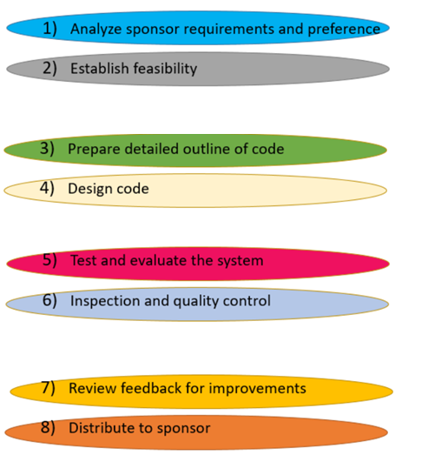
Work Plan
Start Date | End Date | Current Status
3/1 | 3/7 | COMPLETE
3/7 | 3/12 | COMPLETE
3/13 | 3/28 | ONGOING
3/28 | 4/15 | UPCOMING
4/15 | 4/29 | UPCOMING
4/29 | 5/2 | UPCOMING
5/2 | 5/12 | UPCOMING
5/12 | 5/20 | UPCOMING
Sprint 1
Sprint 2
Sprint 3
Sprint 4

